Slide 1
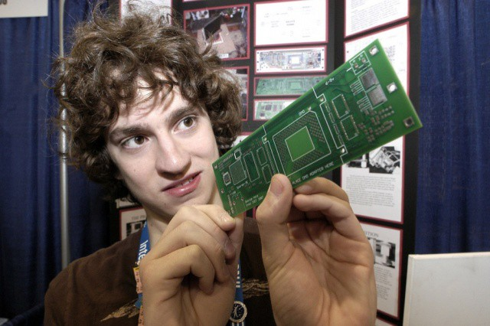
George Hotz v Sony: The Jailbreak of the Playstation 3
By: Jacob Braddock
Charleston Southern University
Figure 1. Geohot A.K.A George Hotz (Heath, 2012)

Slide 2
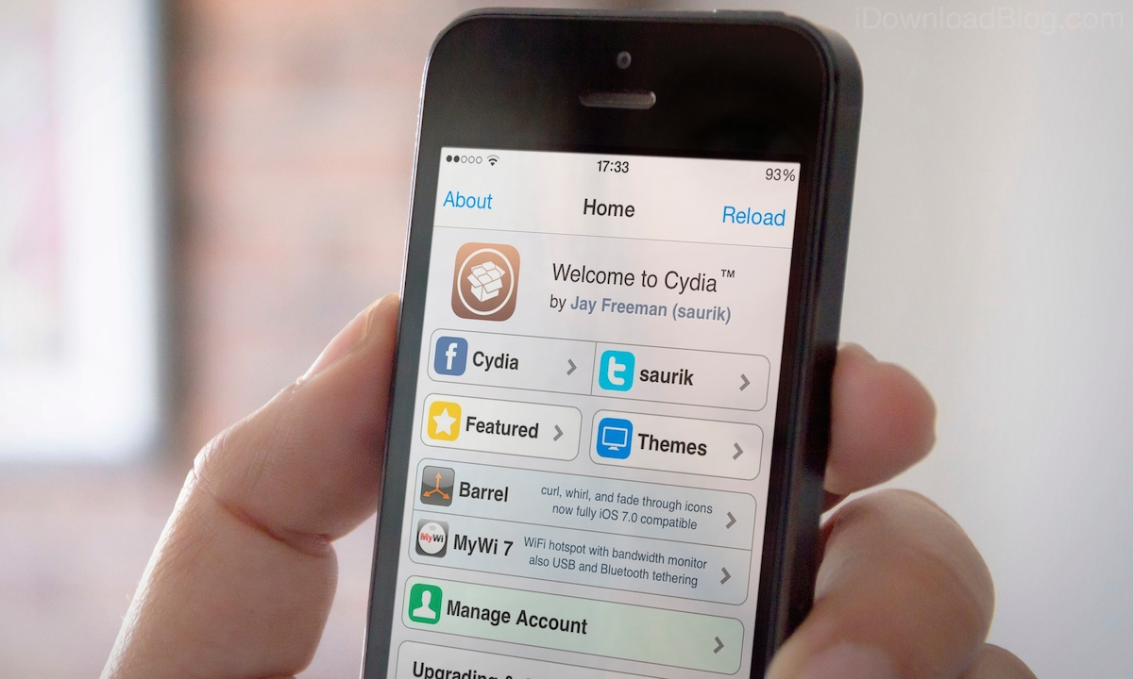
Jailbreaking: What is it actually?
Jailbreaking is the process of removing software restrictions on devices, typically iPhones, to allow unauthorized applications and features (What is Jailbreaking? History, Benefits and Risks, 2023)
The idea of jailbreaking normally is to do things you normally cannot with the intended device (iOS, game consoles, etc)
Rooting is very similar to this process (normally for android devices, which is Linux)
Can also open such devices to attacks and malware, or prevent further outsider service to said device
Figure 2. Visual Image of Cydia (How to Jailbreak, n.d.)

Slide 3

Our Main Character: George Hotz
Security Hacker and Software Dev
At the time, a 19 year old man who had worked on various iOS hacks including removing the SIM Lock on iPhones.
Also developed blackra1n (a jailbreaking software for old iOS models)
Figure 3. Screenshot of blackra1n (BlackRa1n Jailbreak Tool: Everything You Need To Know [How To Use], n.d.)

Slide 4
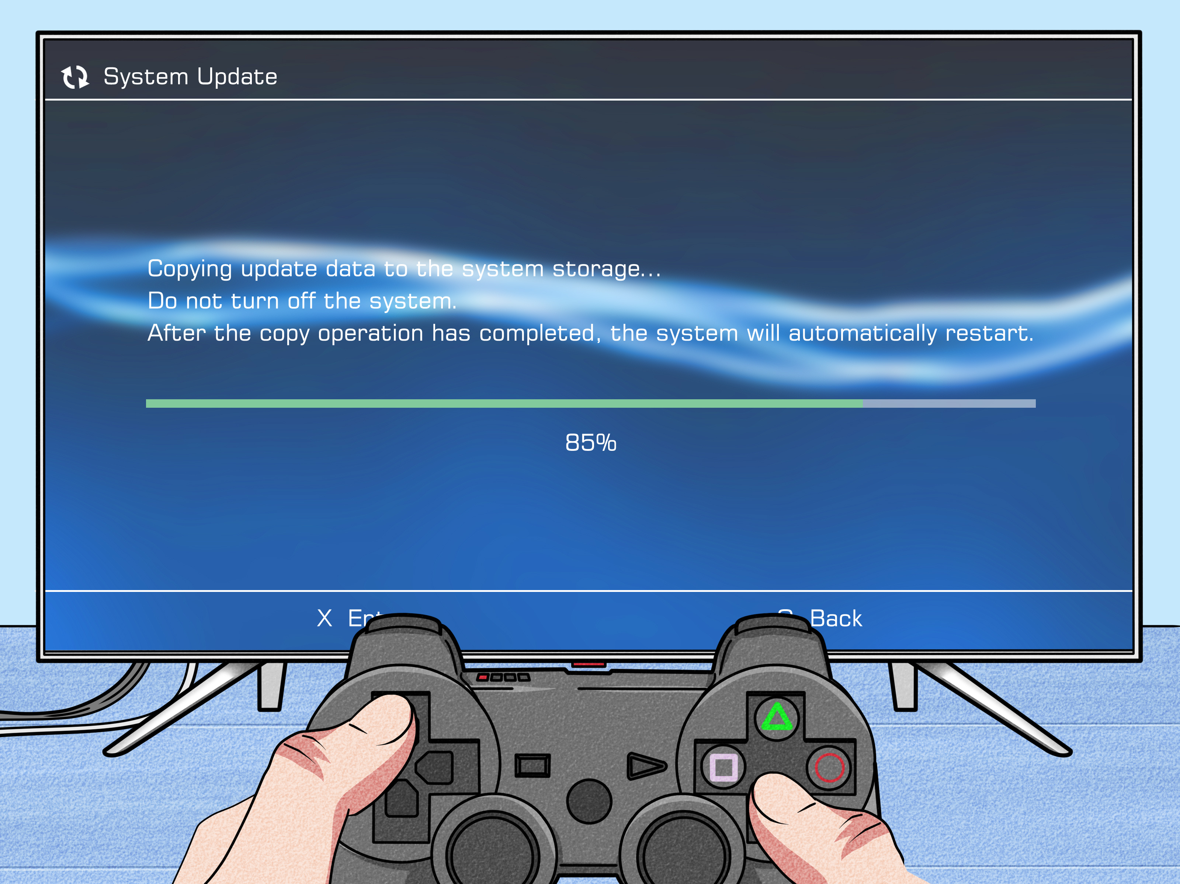
The Jailbreak of the Ps3
Figure 4. Part of a step by step guide to Jailbreak PS3 (Lloyd, 2025)
December 2009, Hotz announces his intentions to crack security of the PS3
January 2010, he succeeds and has the power access the memory management system and has hypervisor level access (think of it like the host)
The exploit is made public later that month and quickly patched that year by Sony

Slide 5
Sony Response
In 2010 December, a hacking group exposed a flaw in Sony ECDSA signatures
Private keys were not published
Hotz posted this key to his own public wesbite
Sony fed up with this constant exposure of system vulnerabilities, sued Hotz for copyright infringement among other charges

Slide 6

The Legal Battle
On top of the lawsuit, Sony pursued more legal actions oagainst Hotz
Temporary Restraining Order to prevent the spread of his jailbreak, and the turnover of all his computing devices and media storage
Hotz opted to respond with a one minute youtube diss track
Eventually, Sony also gain Ips of to all those visiting Hotz website
Eventually the parties settled out of court

Slide 7
The Fallout: Hacktivism
The hacking community was outraged at Sony for what they had done to Hotz
Anonymous and Lulzsec the two major hacking groups going after sony
Anonymous attempted to attack the Sony website, though amounted to nothing
Lulzsec said they had the compromised accounts of one million employes after an SQL injection attack, amounted to nothing as well

Slide 8
Hotz Future after the Lawsuit
Hotz was banned from doing any hacking work on Sony products, therefore killing any jailbreaking of their products
Laundry list of "crimes" committed were filed under the lawsuit, including trespassing, violating the Computer Fraud and Abuse act, etc.
Moved on to developing a rooting hack for the Samsung Galaxy S5
Went on to be employed by major companies such as google, facebook, and twitter, before starting his own companies such as comma.ai and tiny corp

Slide 9
References
BlackRa1n jailbreak tool guide for iphone, iPad, iPod Touch [how to use]. iJailbreak. (2015, October 6). http://www.ijailbreak.com/blackra1n/
Cole, A. (2020, January 9). What is a jailbroken device & what does jailbreaking mean?. Data recovery tips. Recover deleted files on Mac, Windows. https://www.cleverfiles.com/howto/what-is-jailbroken-device.html
How to jailbreak. iDownloadBlog.com. (n.d.). https://www.idownloadblog.com/jailbreak/
Lloyd, J. (2025, April 9). How to jailbreak a PS3 (with pictures). wikiHow. https://www.wikihow.com/Jailbreak-a-PS3
What is jailbreaking? history, benefits and risks. SentinelOne. (2023, March 19). https://www.sentinelone.com/cybersecurity-101/cloud-security/what-is-jailbreaking/

